Slide 1
Advanced Analytics Platform – Strategy & Roadmap
©2018 Discover Financial Services

Slide 2
Platform strategy & vision
Gen I platforms
Cloud Enablement
Gen II platforms
Gen III platforms
Data products & tools
Decision & Deployment

Slide 3
Platform strategy & vision
©2018 Discover Financial Services

Slide 4
Data Technology strategy
Gen I platforms
Teradata stack
Gen II platforms
Hadoop stack
Gen III platforms
Cloud stack
Current state
~90% of business process rely on these platforms
Platform reliability & capacity at risk
Usage patterns have outgrown capability of traditional platforms
Limited adoption across the enterprise
SQL-Hadoop tools sub par performance
Limited usage of Next-gen tools (R, Python, H20)
Cloud-Analytic capability & adoption in its infancy
1st iteration of Data Lake on AWS built around multiple constraints
Future state
Pause (On-premise Hadoop) -
Platform growth
New tools, package installs
Product Builds (eg: Dataflo)
Harden critical platform gaps to support current production processes
Dedicated AWS account, white listed services to build Analytics and Deployment capability
Cloud-certify talent and re-focus team priorities to build Cloud-native platforms / products
Conduct a BCP risk assessment
Platform hardening
Abinitio – Migration to Linux grid
TD – DR for Top 10 applications

Slide 5
Advanced Analytic Platforms : 3-year vision
2018
2019
2020
Decisioning-Deployment
Decisioning-Deployment
Decisioning-Deployment
Batch decision
(Blaze)
Batch decision (Blaze)
Batch decision
(FICO DMP)
Event decision
Batch decision (Blaze)
Batch
(FICO DMP)
Event decision
Auto
Deploy
Auto
Deploy
BI & Analytic Tools
BI & Analytic Tools
BI & Analytic Tools
Tableau
SAS Grid
Hadoop Analytic tools
Tableau
SAS Grid
Hadoop
Analytic Tools
Tableau
SAS Grid
Model training platform
Tableau
SAS Container
Model Training
(H20, Python, R)
Quick
Sight
SAS Container
Data Ingestion & Processing
Data Ingestion & Processing
Data Ingestion & Processing
Batch ETL
Ab Initio
(AIX)
Batch ETL
Ab Initio (Linux)
Cloud ETL
(Ab Initio Containers)
Data Prep
(EMR-Spark)
Batch ETL
Ab Initio (Linux)
Cloud ETL
(Ab Initio Containers)
Data Prep
(EMR-Spark)
Real-time
ETL
Real-time
ETL
Data Storage
Data Storage
Data Storage
EDW
Teradata
(300TB)
Data Lake
Hadoop
(700TB)
EDW
Teradata
(300TB)
Hadoop
(300TB)
Cloud MPP
Snowflake (300TB)
Teradata
(200TB)
Cloud MPP
Snowflake (500TB)
Data Lake
S3 (1 PB)
Data Lake
S3 (1.5 PB)
On-premise Platforms
AWS Hosted Platforms

Slide 6
Advanced Analytic Platforms : Key milestones
New AWS Account created for Analytics
AWS Analytic services setup
Ab Initio
Linux infra setup
EDS Archive migration to AWS complete
TD Top 5 CRD complete
AWS core platforms
May 2018
Jun 2018
Jul 2018
Aug 2018
AWS Data migration products
Oct 2018
Sep 2018
Model training platform (H20)
Cloud MPP (Snowflake)
BI on the cloud
Real-time data platform & products
AWS – Analytics (Phase II rollout)
Reduce Hadoop footprint
AWS – Analytics (Pilot rollout)
TD to AWS pilot migration
GraphDB on the Cloud
Dec 2018
Model deployment platform
AWS Prod account – HA – DR setup
Q1 2019
Q2 2019
Q3 2019
Q4 2019
TD bulk migration complete
Ab Initio
AIX – Linux migration complete
AWS – Deployment
(Production) Pilot rollout
Decisioning platform on the cloud
Batch ETL (Ab Initio) on the cloud
Real-time ETL on the cloud
Production jobs phased rollout to the cloud

Slide 7
Gen I platforms Owner: Todd Bruns & Anthony Piecz
©2018 Discover Financial Services

Slide 8
BCP update
Gen I platforms : Status of BCP plans
Review of BCP plan and platform dependencies with business groups – COMPLETE
Inventory of TD, SAS, Tableau users
Inventory of existing BCP plans
Reconcile existing plans & identify missing plans
Gap assessment (Process & platform) – End of June
Remediation design and timelines - End of July
✅
✅
✅

Slide 9
Gen I platforms : Operational resiliency
Gen I platforms : Operational resiliency
 | Apr | May | Jun | Jul | Aug | Sep
Teradata
Retire faulty script (Feb outage) | Complete
Harden recovery process (Feb outage) | Complete
Implement query throttle |  | Complete
Disable TD Protegrity agent
TD upgrade to 16.10
Eliminate Beacon Dependency
Ab Initio
Sync EME between data centers | Complete
Revoke ad-hoc users from prod grid
Restricted read access for CRD
Resilient landing directory
Retire Harmony w/ Maestro (SLA Dashboard)
SAS
Additional memory to users jobs | Complete
Add workspace for users (75TB) |  |  | Complete
SAS archive improvements
Tableau
Additional capacity
Upgrade server OS
Upgrade Tableau

Slide 10
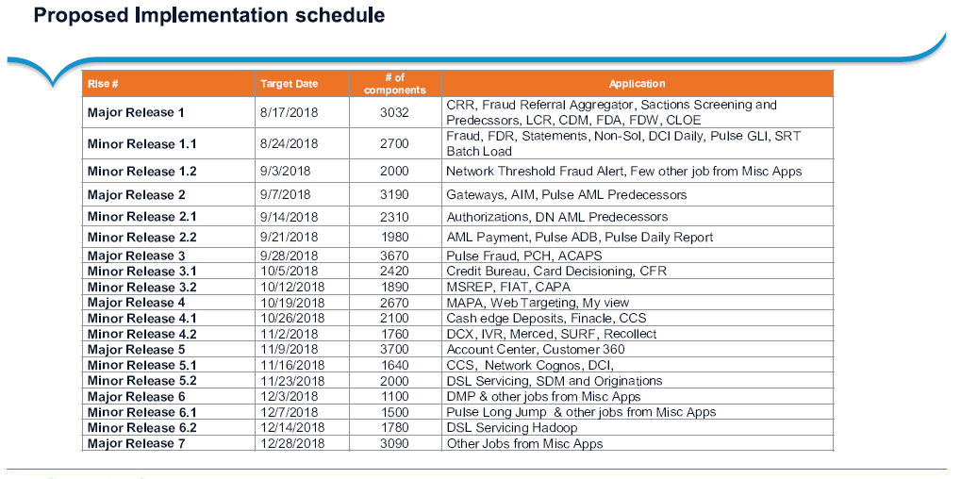
Ab Initio : AIX to Linux migration schedule

Slide 11
Cloud enablement Owner: Brandon Harris
©2018 Discover Financial Services

Slide 12
Cloud account structure for Analytics & Deployment
 | AWS Account - Analytics | AWS Account - Deployment
Purpose | Model development BI development Analytics | Model deployment BI production schedules
Access to production data | Yes | Yes
Access | Business development BT development | BT production support
Platform SLAs | Some downtime acceptable | Highest level of response and support
AWS services | Wider list of services for analytics research | Narrow list of services to ensure supportability
Open for business | End of Aug 2018 | End of Feb 2019

Slide 13
Cloud Architecture

Slide 14
User Experience
CURRENT STATE
”Manual” automation – Manual execution of Jenkins job. Requires manual call to Vault for secret information, Terraform deploys infrastructure.
Debug and logging of deployment pipelines is difficult and cumbersome.
Difficult to manage codebase
Teams and users have no insight into usage or costs.
FUTURE STATE
One-click provisioning of custom and right-sized analytics infrastructure for users and teams.
Deployable “pods” of commonly used infrastructure / services / software.
Optimized ”sleep-window” scheduling and environment expiration for cost management.
ServiceNow integration for compliance and governance needs.
No coding required (but available if needed!)

Slide 15
Cloud security
ACTIVE ENVIRONMENT
REMEDIATION
Real-time monitoring and alerting of CloudTrail events to ensure compliance of resource configuration to DFS standards (Warden).
Resources out of compliance are remediated or terminated automatically.
All compute-based instances are DFS RHEL 7.4 based with included security standards and controls (Centrify, CarbonBlack, etc..).
No custom / unapproved AMI (server images) are available.
COMPUTE
All storage ensures data is encrypted at rest vis AWS-SSE (AES-256) Encryption.
TOP-5 CRD Tokenization for user-accessible data.
STORAGE
No internet gateway / accessibility.
All traffic in user-based systems is encrypted in motion via TLS/SSL.
NETWORK

Slide 16
Roadmap – AWS Data services
CLOUD ENABLEMENT / GEN III INFRA
CAPABILITIES AND SERVICES ROADMAP
Current state | PI3 & PI4 | FUTURE PI’s
Manual Provisioning with Automation Pipelines S3 RDS (MariaDB) RedShift (manual) EMR w/ Analytics Edge Node EC2 Glue Metastore ELB Security Groups DynamoDB Lambda (manual) | Full Self-Service / Automated Provisioning (Analytics Environment) Logging and Alerting Platform (Analytics Environment) Glue Crawlers Neptune RedShift (automated) Kinesis EFS SNS SQS ElasticSearch SageMaker | Full Self-Service / Automated Provisioning (Deployment Environment) Logging and Alerting Platform (Deployment Environment) RedShift Spectrum Aurora Athena ElastiCache Lambda (automated) Kinesis Firehose QuickSight

Slide 17
Gen II , Gen III platforms Owner: Shannon Schultz
©2018 Discover Financial Services

Slide 18


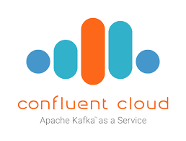







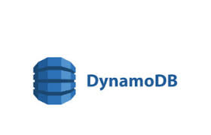
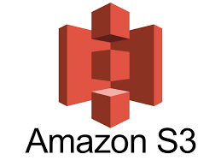

Data Service / Access (e.g. JDBC/ODBC/REST)
Next Generation Platforms Landscape
Tableau
End User (SQL)
Model training
Presentation layer
MPP
Batch / ETL
Real-time
NoSQL
Data Processing layer
EMR
RDS
Neptune
Neo4J
Enterprise Data Lake - SOT
Data storage Layer

Slide 19



Data storage : S3 Bucket Standard
Quarantined Bucket
DFS-DATAHUB will hold the production Data Hub archives. Bucket access will be restricted to only the Data Hub application for archiving and restoring data to/from the on-premise DS-ETL Grid
Enterprise Data Lake
DFS-ANALYTICS-DLT-USE1-ENT-SOT will hold our production “source of truth” data to be used for such things as BI dashboard, reporting, ad-hoc analytics, model training and model execution. Data under the SOT has all been classified, tokenized, and optimized for consumption.
DFS-ANALYTICS-DLT-USE1-ENT-SOR will hold our raw production data that is only business consumable under approved circumstances. This data has not necessarily been classified, tokenized, and/or optimized for consumption but more is a record of source system data as we received it.
DFS-ANALYTICS-DLT-USE1-WORKSPACE-SOT-ETL this will used to hold temporary internal project related test SOT data for project development and testing use cases. (Provisioned under the AA AWS Dev account)
DFS-ANALYTICS-DLT-USE1-WORKSPACE-SOR-ETL this will used to hold temporary internal project related test SOR data for project development and testing use cases. (Provisioned under the AA AWS Dev account)
DFS-ANALYTICS-DLT-USE1-WORKSPACE-PA-{env}-SOT this will used to hold temporary PA SOT data for Production Assurance related test runs. (Provisioned under the AA AWS Test account)
DFS-ANALYTICS-DLT-USE1-WORKSPACE-PA-{env}-SOR this will used to hold temporary PA SOR data for Production Assurance related test runs. (Provisioned under the AA AWS Test account)
DFS-ANALYTICS-DLT-USE1-WORKSPACE-{Business Unit} this will contain BT and Business user and/or team-based work spaces for data experimentation and exploration.

Slide 20
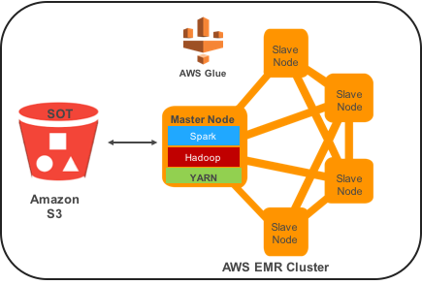
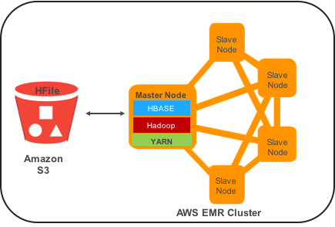
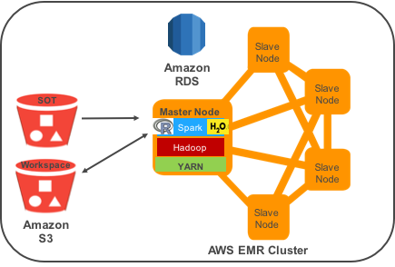
Data processing layer : EMR patterns
ETL Workloads
- Utilized for processing ETL workloads
- Spark is managed by YARN
- Nodes are EC2 m4.2xl (Master), r4.2x (Core, Task nodes)
- Integration with Glue Metastore
- Long running cluster, auto-scaling & auto-suspend is enabled
Operational Workloads
- Utilized for operational analytic applications needing
- HBase powered, managed by YARN
- Nodes are EC2 m4.2xl (Master), m4.10 L (Region Servers)
- Root Data is stored on S3, Write Ahead logs are stored on local HDFS
- Transient clusters used for specified applications (i.e. Fraud Scanner)
Analytic Workloads
- Utilized by business users for adhoc analytic workloads
- Spark, H2O / Sparkling Water, R, Python managed by YARN
- Nodes are EC2 m4.2xl (Master), r4.2x (Core, Task nodes)
- Integration with common RDS (Postgres)
- Long running cluster, auto scaling and auto suspend is enabled

Slide 21
Storage, Compute and Services are decoupled which ensures easier scaling based on the application and user needs.
Cloud MPP - Snowflake Architecture
Storage
S3 storage using micro partitions to store the data and are automatically encrypted at rest.
Compute
Data is processed as micro data warehouses. Maximized by caching data frequently used.
Services
Authenticates user sessions, enforces security functions, optimizes queries and coordinates all transactions
Transactions
Security
Management
Ad hoc analytics
Centralized storage
Development
Loading
Meta data
Optimization

Slide 22
Snowflake / Redshift / Teradata Comparison
Measurement | Snowflake | Redshift | Teradata
Performance (Customer Use Case - Need to verify in POC) | Up to 10x+ faster than competition. | Snowflake 4x faster in TPCDS testing. | Snowflake has been 2x-10x faster in customer POCs.
True Elasticity | Storage, compute and concurrency scale independently. Compute scales in seconds and concurrent auto-scales. Virtually no concurrent query limitations. (potential latency from cloud services being separate from caching layer | Clusters require read only mode to scale. Scaling takes hours - days depending on data volume. Single clusters have a hard concurrent query limitation (500 Users). | Requires significant downtime to scale. Cloud offering still requires 8+ hours to scale. Workload manager offers better concurrency scaling
Cost | Per second billing on compute that auto-suspends when users are not active significantly lowers operating costs. SaaS delivery provides lowest cost of management. | Per hour billing on compute with no ability to suspend/resume compute requires clusters to run 24x7 regardless of users actively on system or not. | Comparatively, still the most expensive DW in the industry.
Time to Value | No setup, configuration, database patching, or ongoing performance tuning required. Encryption, backup, and synchronous replication automatically built-in. | Setup and ongoing administration required. FTEs to manage clusters, sort/dist keys, stats, vacuuming. Patching requires downtime. | - Significant setup, specialized skills and ongoing administration required.
Additional Value | Supports flexible schemas (i.e. JSON, XML) Native support for Python and node.js Built in DR solution by utilizing S3 | AWS Managed Service Proven high performance for BI / Reporting Use cases | - Current skill set and proven technology at DFS

Slide 23
Advanced Analytic Gen II & Gen III Capabilities Roadmap
Category | Capability | Value | Key Features | Timeline
Gen II Platform | Continue BAU for Hadoop platform while AWS build is , no new applications. Reduction plan for Hadoop Enterprise Data Lake | Promotes migration to cloud platforms Reduction in Hadoop footprint with cost savings | Migrate data to S3 / delete from HDFS Finish key Hadoop HA initiatives Decommission Hadoop nodes | EDS Data Migration to S3 – July 2018 Decommission 40% of Hadoop Nodes & new ELA – Oct 2018
AWS Platforms – EMR, RDS, S3 | Build cloud native platforms to support Advanced Analytic Capabilities | Decoupled architecture for purpose built platforms to support functional use cases | EMR Cluster Builds (Data Processing, Operational, Analytic User) MPP Technologies S3 Buckets supporting ONE Architecture Realtime platform build Graph DB Build | SOT Objects enabled & MVP EMR, Redshift – Q2 18 Snowflake POC – Q2 18 Snowflake Buildout – Q4 18 Realtime Platform MVP – Q4 18
Platform Optimization | Optimize next generation platforms to adapt to both batch and real time use cases and provide a “best in class” user experience | Scale platforms easily for a better user experience Enable real time decisioning capabilities and rapid deployment of rules and models | Capacity management of each platform Long running vs transient platforms identified | Fully optimized EMR platform – Q3 18 Usage metrics reporting – Q4 18
Platform Security | Build secure platforms that meet all Enterprise Data Security Standards and audit criteria | Ensure data security measures are in place on next generation platforms and tools | Encryption Authorization Access Controls Access Auditing and KRI’s Reporting | SAML Integration & logging – Q2 18 Full Access Controls & Access Management – Q3 18
Platform HA & DR | Ensure all services are highly available and that a fully automated DR capability has been built out. | Ensure system meets a 99.9% availability req. Ensures data backup and disaster scenarios are accounted for in SC Plan | Document procedures to recover platforms in event in DR event Ensure key services are set up with HA | HA Services for EMR – Q2 18 DR plan documented – Q4 18

Slide 24
Cloud Data Enablement Owner: Brent DeMar
©2018 Discover Financial Services

Slide 25
Cloud Data Enablement: Strategy
Tools to Export
Teradata Historical Data
Ongoing/ New Data from Ab Initio
MPP DB Storage
Load to Redshift
Load to Snowflake
S3 Storage
AVRO format
ORC format
Accessible via Glue DB services (EMR,Athena,Spark)
Standards
Naming
Metadata / Tagging of data
Ingestion playbooks
Cloud Data movement strategy
Build tools to synchronize data already in Teradata, and new data generated by Ab Initio to AWS.
Store data in an MPP database (redshift/snowflake).
Store data in S3 in modern efficient data formats and make accessible to services such as EMR/Spark & Athena.
Standards
Logical Architecture
Teradata
S3
AWS
Exporter Application
AVRO to ORC
& Glue
Process
S3
Redshift
Load
Files

Slide 26
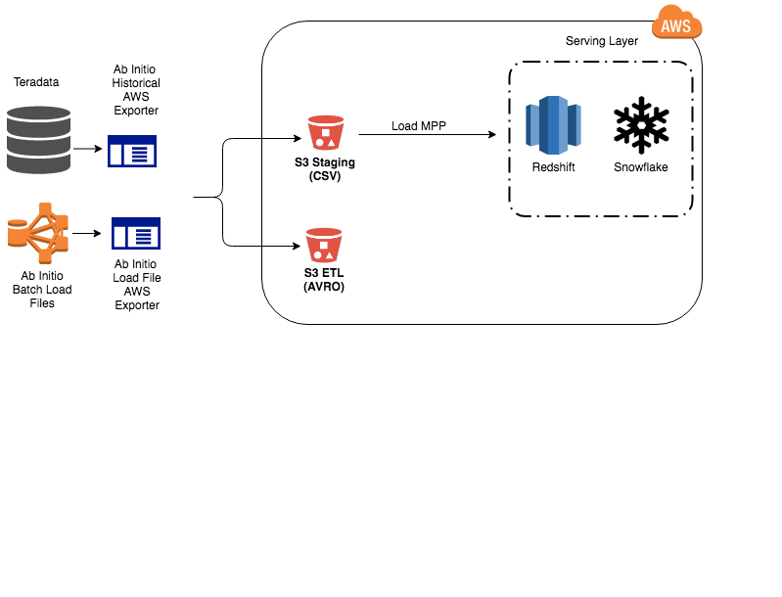
Deep Dive - Teradata to Redshift
Ab Initio AWS Exporter:
Generic Ab Initio application that can be operated in 2 modes
Teradata Historical/Backfill
Data Op teams can specify a Partition range of historical data from Teradata, and let job run unscheduled
Scheduled Ongoing
Data Ops teams will schedule AWS Export job to run after load file creations or EDS Catalog of source file
AWS Exporter Features
Parameter Driven for flexibility
Can supply partition ranges (usually Date “procDate”) for bulk “backfill” syncing
Convert source data to AVRO and store on S3
Redshift Loading (Convert src data to compressed small CSV files and store to S3, issue Redshift COPY SQL command)
Support of Insert, Complete Overwrite, Upsert load strategies to Redshift
AVRO Data stored on S3 will have Metadata & Tags assigned to it. Link (Metadata & Tags Standard)

Slide 27
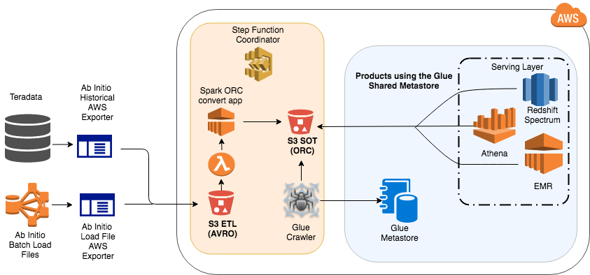
Deep Dive - AVRO to ORC S3 & Glue Process
S3 Data & Glue
Automated AVRO to ORC Columnar format conversion & register with Glue Metastore
AVRO file lands in S3 starting a Lambda function which kicks off a Step Function state machine
Step functions coordinates ORC Spark conversion process on EMR ETL cluster & Preps Glue for crawling
ORC Conversion conversion completes & Glue crawler obtains schema and metrics about new ORC data
After crawler completes, data is now SQL accessible via EMR(Hive/Presto/Spark), Athena, Redshift Spectrum
ORC Conversion & Glue Database Features
ORC Conversion is a Spark application that runs on an auto-scaling EMR cluster that can grow with demand
Glue crawlers obtain schema from AVRO files, which in turn get schema from Ab Initio DML of the original data
Glue crawlers automatically handle schema evolution and will update Glue DBs appropriately!
Data is loaded in Insert/Append mode only
Coordination happens via Step Function State machine. Errors will be sent as Cloudwatch Events

Slide 28
Cloud Data Enablement - Roadmap
PI & Date | Cloud Data Enablement – Future Road Map
PI3: 7/31 | AWS Data Export tools available (Preview Release) Sources (Teradata, Load files, DML mapped EDS files) Destinations (S3 Avro, S3 ORC, Glue DBs, Redshift)
8/1 – 8/31 | Teradata Data Migration Pilot w/ Card Data Ops 1 & 2
PI4: 9/1 | AWS Data Export tools - General Availability for other Data Op teams
PI4: Q4 2018 | AWS Data Export tools: Snowflake loading support Semi—structured JSON data capability
PI4: Q4 2018 | Real Time data Ingest Tooling (Preview Release) No real-time ETL
PI5: Q1 2019 | Real Time data ingest Tooling Pilot & GA release
PI5: Q1 2019 | Ab Initio on the cloud platform design

Slide 29
Data Catalog Products Owner: Brent DeMar & Tim Bielinski
©2018 Discover Financial Services

Slide 30
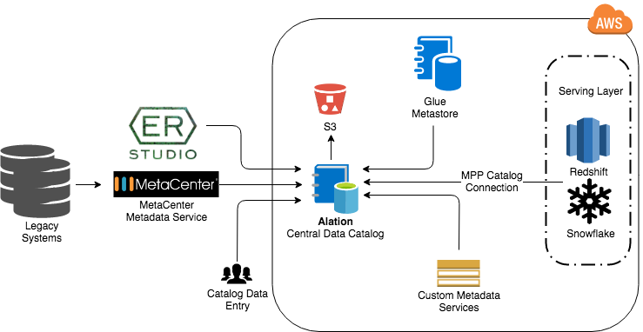
Data Catalog Products: Alation Central Data Catalog Strategy
User Interface
Modern and Intuitive
Made for Data Analysts & Scientist
Integration
Cloud & On-Prem data sources
DB Modeling tools
BI Tools
Rich APIs
Interface w/ 1st & 3rd party metadata providers
Crowd Source
Scale out institutional knowledge
Catalog common SQL
Alation Architecture:

Slide 31
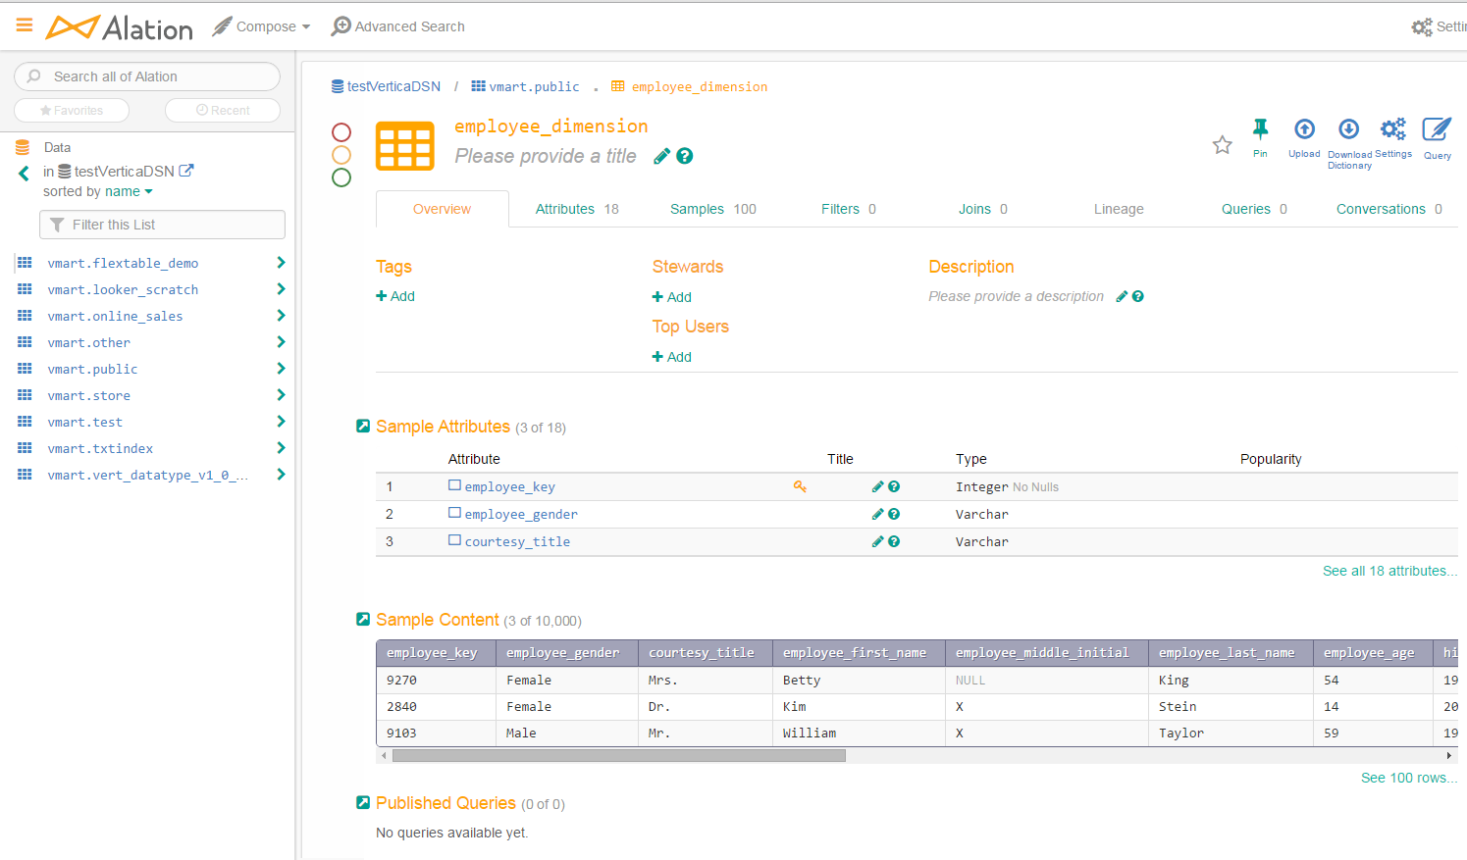
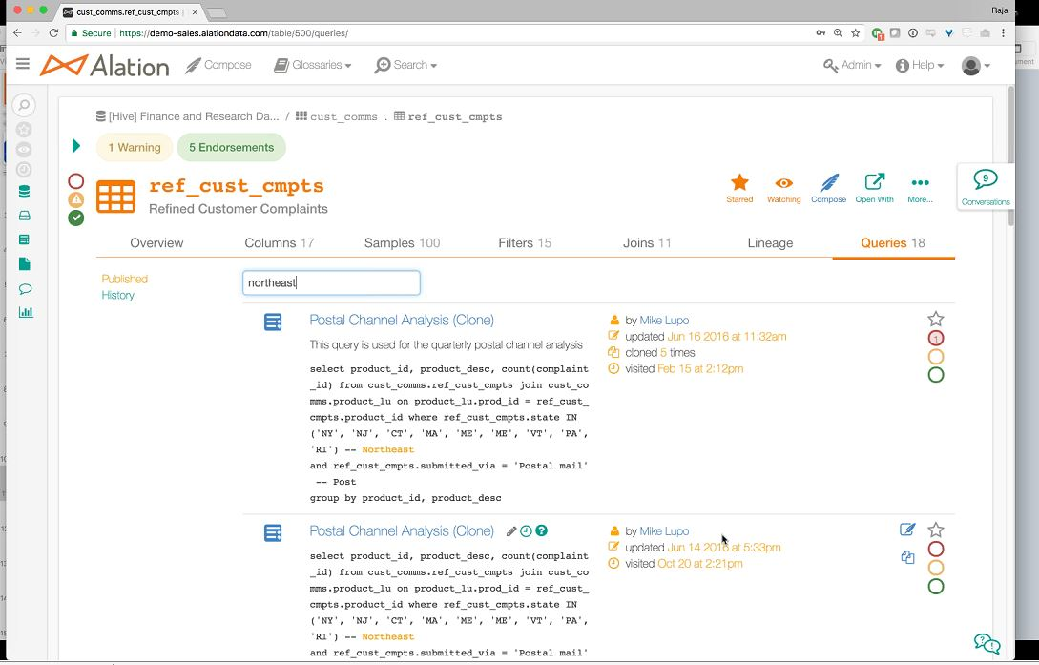
Data Catalog Products – Alation First Look
Table Overview Page
Cataloging of common SQL queries

Slide 32
Data Catalog Products – Future Roadmap
New agile team “Data Catalog Products” that will integrate into the next Adv Analytics PI.
Start off with a few sources & integration points, and expand capability over time.
Initial Features for next PI4
8/31 Installation of Alation in AWS Analytic Environment
8/31 Integrate with Redshift / Glue Metastore DBs / Teradata subset
4th Qtr 2018 Data Import from Metacenter (Business definitions, subset governance information)
4th Qtr 2018 ER Studio Integration
PI & Date | Data Catalog Products – Future Roadmap
PI5: Q1 2019 | Continue Teradata Integration
PI5: Q1 2019 | Snowflake Integration
PI5: Q1 2019 | Tableau Integration
PI5: Q1 2019 | S3 Objects (not managed by Glue)
PI5: Q1 2019 | Metacenter connector replacements with direct connection to Alation
PI6: Q2 2019 | Metacenter Retirement

Slide 33
Data Quality Products Owner: Brent DeMar & Tim Bielinski
©2018 Discover Financial Services

Slide 34
Data Quality Products: DQ Strategy
Data Profiling
Ab Initio ETL Integration
Balance & Control
Business DQ
Rules
Data at
Rest DQ
The solution will increase visibility to the quality of all data with focus on critical data elements.
Deploy a new agile team “Data Quality Products” that will integrate into the next Adv Analytics PI.
Initial Features for next PI4
7/13 Next Gen Data Quality tool product evaluation
Q4 2018 Next Gen DQ tooling available (Preview Release) in Dev, QA
PI & Date | Data Quality Products – Future Roadmap
PI5: Q1 2019 | Next Gen DQ pilot in production
PI5: Q1 2019 | Next Gen DQ tooling available (General Availability 1.0)

Slide 35
Decision & Deployment Owner: Eugene Goldberg
©2018 Discover Financial Services

Slide 36
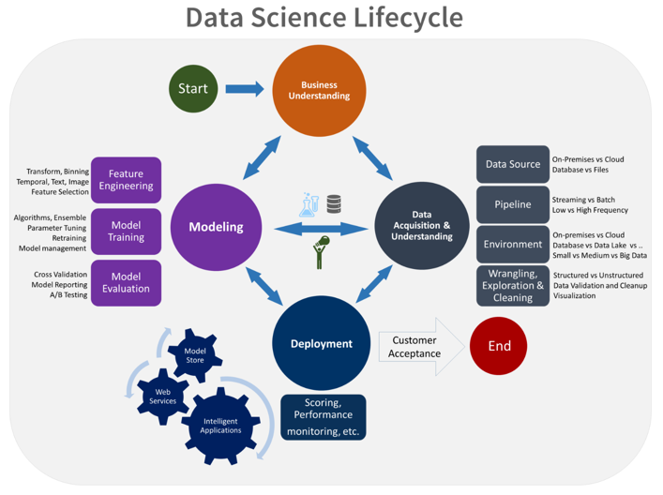
Data Science Lifecycle – Model development to deployment
Business Understanding
Data Acquisition and Understanding
Modeling
Deployment
Customer Acceptance

Slide 37
Model training platform – Lessons from CECL
RAW DATA
DATA PREPARATION
VARIABLE SELECTION & MODEL TRAINING
One time data movement from Teradata to S3 in AWS took ~8+ days for 10TB Compressed data
ON-PREM SAS + TERADATA
1% data set does not complete On-Prem and had to be partially run in SAS Container:
~69hrs total runtime
(38hrs On-Prem + 31hrs in Container)
For 0.5% data 30% segment 100 variables ~36hrs runtime
CLOUD SAS CONTAINERS
For 0.5% data 30% segment 100 variables ~6hrs runtime
For 1% data 30% segment 197 variables ~27hrs runtime
CLOUD SAS CONTAINER + REDSHIFT
For 0.5% data set ~20hrs runtime for full process
Not Applicable
CLOUD H2O + SPARK
For 1% data 30% segment 197 variables
~43mins runtime
1% data set
~3 hours
*Note: Most iterations and model analysis occur here

Slide 38
Cloud-based Decision & Deployment platform
Presentation layer
Data layer
Pattern I : Model training on H20
Model deployment
Model Scoring
S3
Data prep
Model training
Pattern II : Model training on SAS
Redshift
Decision platform
(FICO)
Redshift
RDS
Data prep
Model training

Slide 39
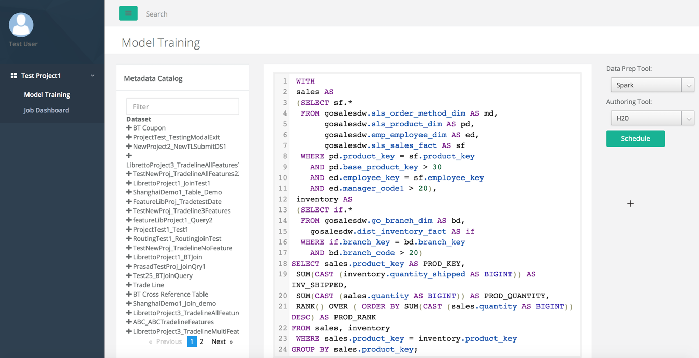
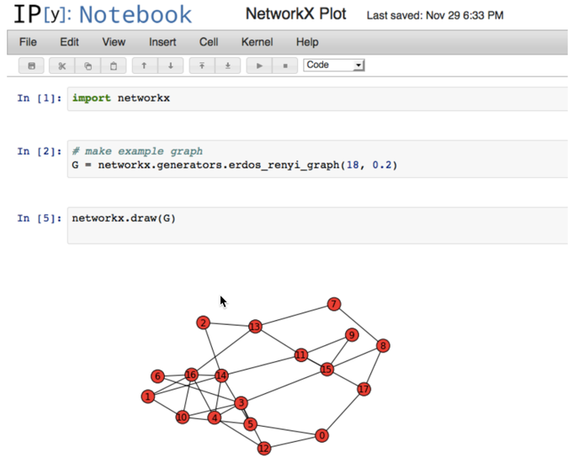
Model Training platform : User Experience
Data Discovery & Preparation
Model training

Slide 40
Decision platform update
Batch Decisioning
Event Decisioning
FICO Decision Management platform (DMP)
Current state :
Hosted on AWS under FICO’s account
Collections strategy is the first use case deployed on FICO DMP
Combines Real-time data with historical data from the Data Lake to come up with custom payment plans within seconds
Future state :
Insource the platform under DFS’s AWS account
Blocker : Delay in product release by the vendor, current ETA , end of July
Dev platform on DFS cloud – YE 2018
Product platform on DFS cloud – Mid 2019
Event decisioning platform (Scanner)
Current state :
Event-based decisioning for Account takeover Fraud deployed on Hadoop
End to end automation from Real-time pattern detection, Rules & Strategy orchestration and case generation
Reduced the time to detect and respond to Offline Fraud from 7 days to minutes
Future state :
Re-platform the Scanner application on the Cloud
Dev platform on DFS cloud – YE 2018
Product platform on DFS cloud – Mid 2019

Slide 41
Program features Owner: Chris Butler
©2018 Discover Financial Services

Slide 42
Top 30 Features by priority
Program Increment (PI#4) – Q4 2018 (Sept-Dec)

Slide 43
Appendix
©2018 Discover Financial Services

Slide 44
Ab Initio
DR resiliency plans
Gen I platforms : DR resiliency
Medium term (Mid 2018 – Mid 2019)
Long term (2019 - 2020)
On-premise re-host from AIX to Linux
Benefits :
Move away from older infrastructure
Removes single points of failure
Linux OS allows for cloud portability
Timelines :
Stand up new infrastructure – June
Pilot migration – July
Fixed bid migration – Q3 ’18 to Q2 ’19
($675K plus $150K performance bonus)
Cloud-based Ab Initio Linux containers
Benefits :
Move ETL closer to Cloud data lake
Faster data availability
Timelines :
Abi on Cloud pilot – Q4 ‘18
Abi Cloud platform setup – Q2 ’19
Migration – Mid ‘19 to Mid ‘20

Slide 45
Teradata
DR resiliency plans
Gen I platforms : DR resiliency
Medium term (Mid 2018 – Mid 2019)
Long term (2019 - 2020)
DR remediation of Top 10 applications on existing On-premise TD platform
Benefits :
Address critical application gaps
Leverage existing DR capacity
Timelines :
Coincide with Ab Initio re-host
Fixed bid remediation – Q3-Q4 ’18
Open Issues :
TD disk capacity depleted in 9 months
TD CPU capacity currently depleted
Cloud-based MPP Data platform
Benefits :
No further investment in TD
Higher resiliency on the Cloud
Timelines :
Copy of TD data on AWS S3 - End of Q3
POC of Cloud based MPP (Redshift / Snowflake) – July ‘18
Procurement phase – End of Q3 ‘18
Production platform – Q1 ’19
Workload migration – 2019 - 2020

Slide 46
SAS
DR resiliency plans
Gen I platforms : DR resiliency
Medium term (2018)
Long term (Q4 ‘18 - 2019)
Add storage capacity to SAS Grid
Benefits :
Temporary capacity for ongoing work
Timelines :
July 2018 ($268K)
Container based Model training platform on the Cloud
Benefits :
No further investment in TD
Higher resiliency on the Cloud
Timelines :
Prototype of SAS on AWS – End of July
Model training platform pilot – August
Multi-tool support (H20, Python, SAS) – Q3 ‘18 to Q4 ‘18

